Slide 1

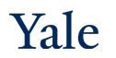
Deep Learning Architectures and Final Project
CPSC/AMTH 452/552
CBB 663

Slide 2
Outline
Deep learning architectures
CNNs
RNNs
Autoencoders
Word embeddings
Transformers
Generative models (e.g. GANs)
Graph Neural Networks
Ultra deep learning (ResNet)
Neural ODEs
Project Specifics
Potential Topics
Format of proposal and report

Slide 3
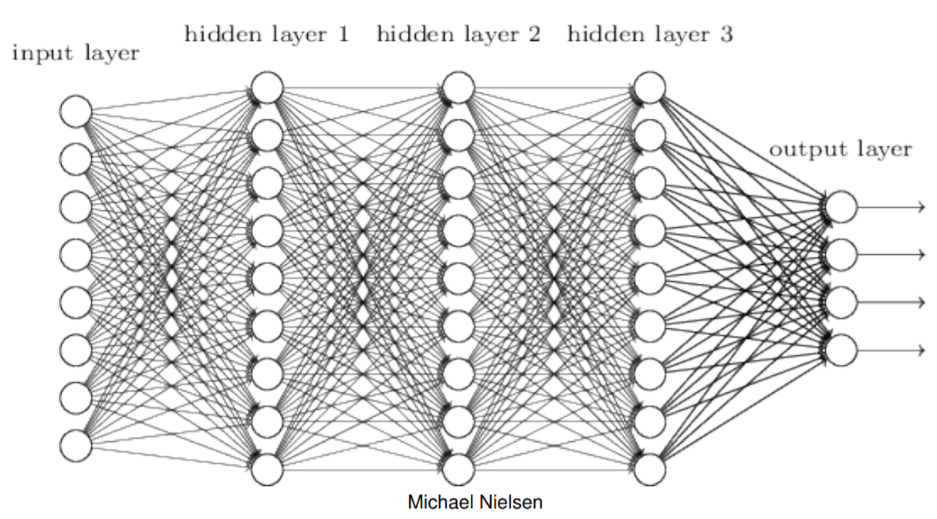
Fully connected network
Every feature interacts with every other feature
Weight matrix at every level allowed to be dense

Slide 4
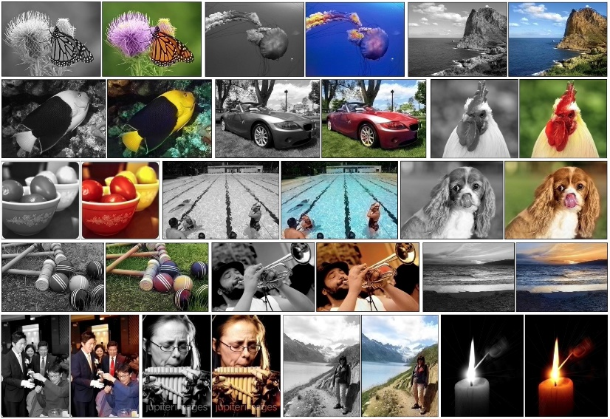
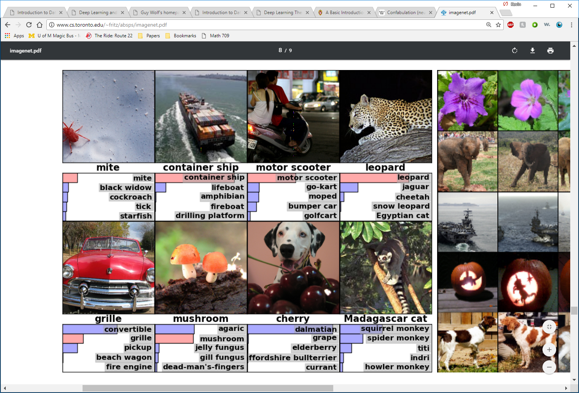
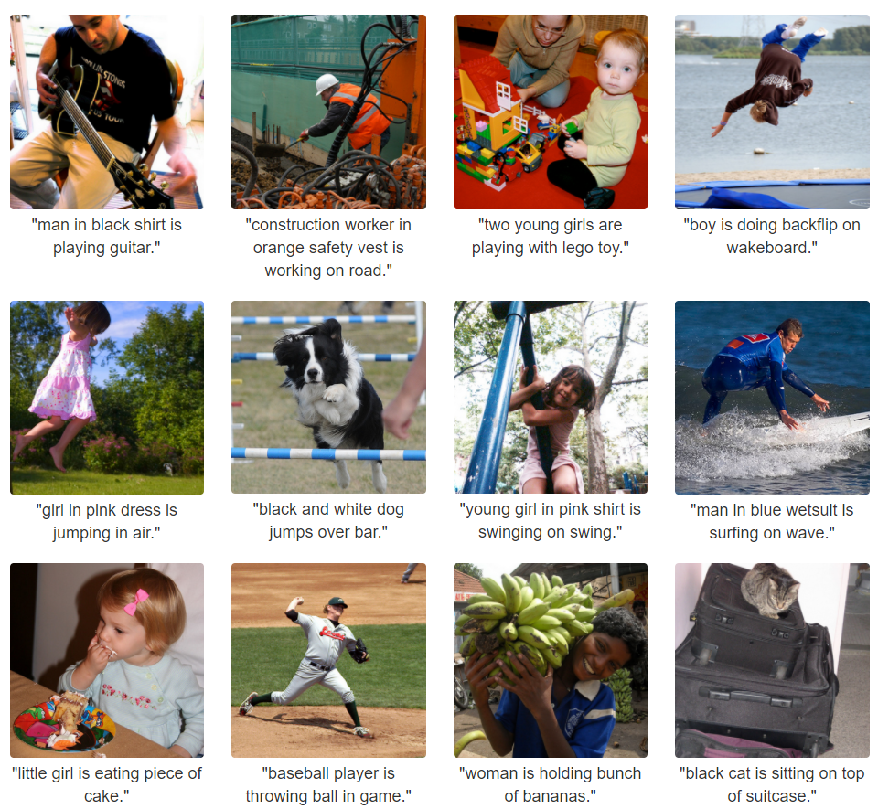
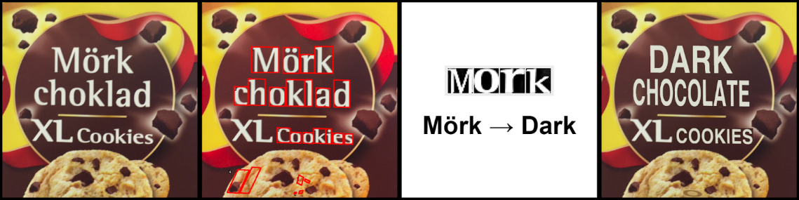
Convolutional Neural Networks (CNNs)
Very successful in images
Notes:
Emphasize that CNNs were used for object detection in bottom left

Slide 5
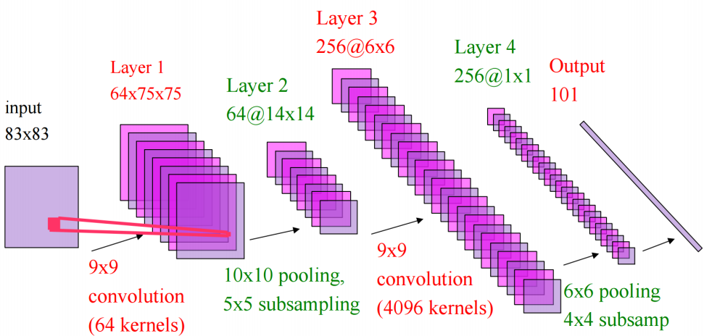
Convolutional Neural Networks (CNNs)
Only pixels that are close to each other in the image interact with each other (convolution layer)
Weight matrices are highly structured
“Pooling” helps to simplify output of convolution layer
Yann LeCun

Slide 6
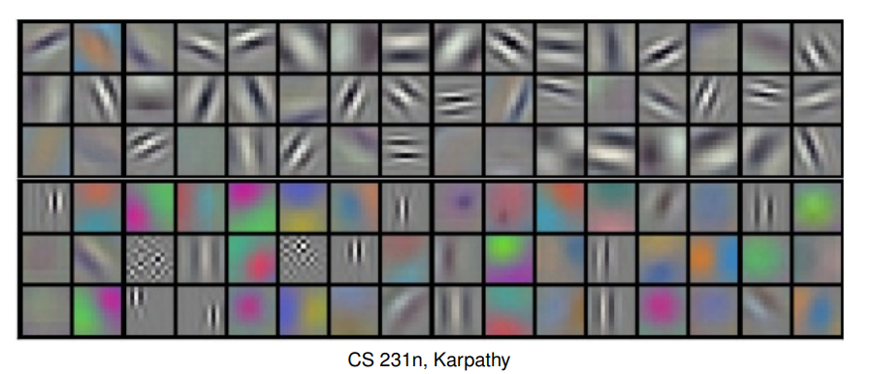
Convolutional Neural Networks (CNNs)
Weights from the first layer tend to look like directional filters after training
Detects edges, color change, etc.

Slide 7
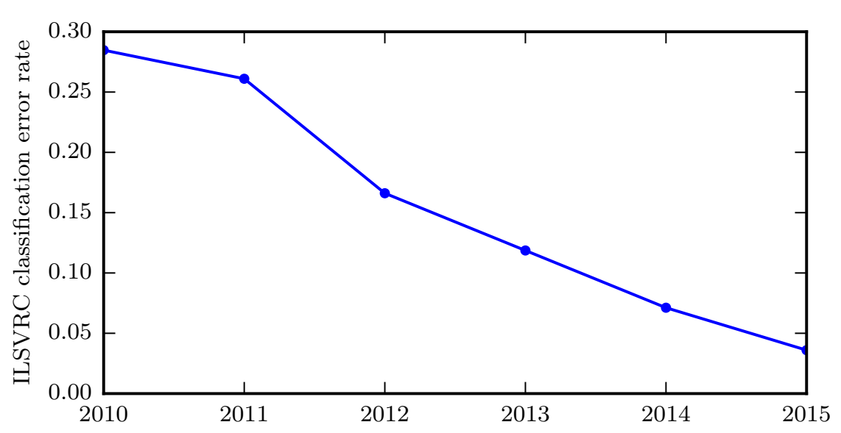
Convolutional Neural Networks (CNNs)
Goodfellow et al., 2016
Notes:
Deep neural networks have led to great success in image classification every year, largely due variations on CNNs

Slide 8
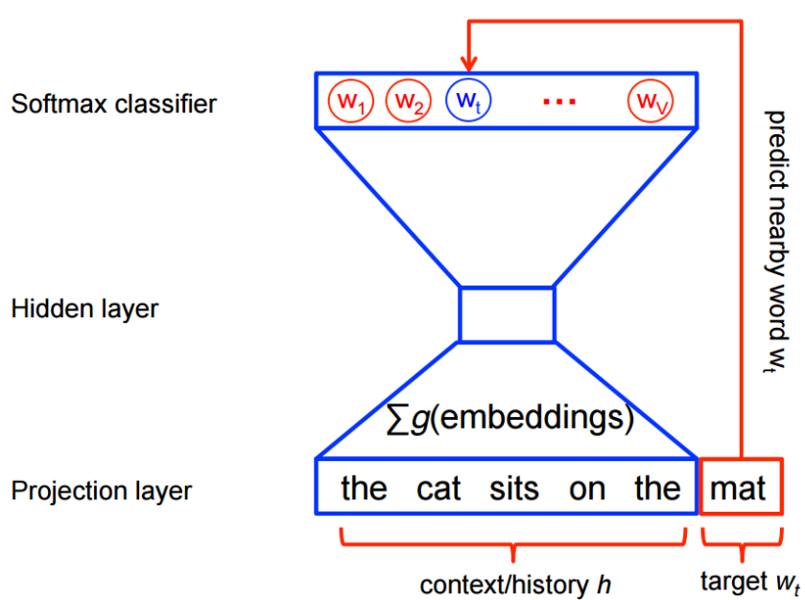
Word2Vec
Organization of words via neural networks
Next word in a sentence can be predicted based on organization
Notes:
Note that input is on the bottom

Slide 9
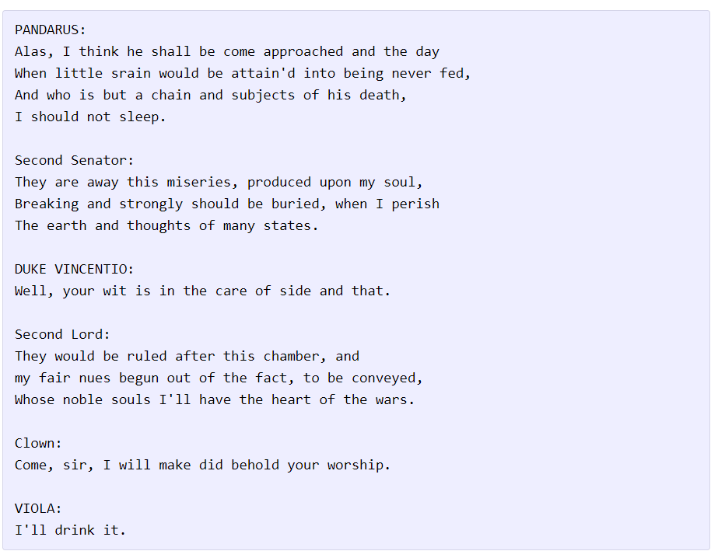
Recurrent Neural Networks (RNNs)
Useful when time is important

Slide 10
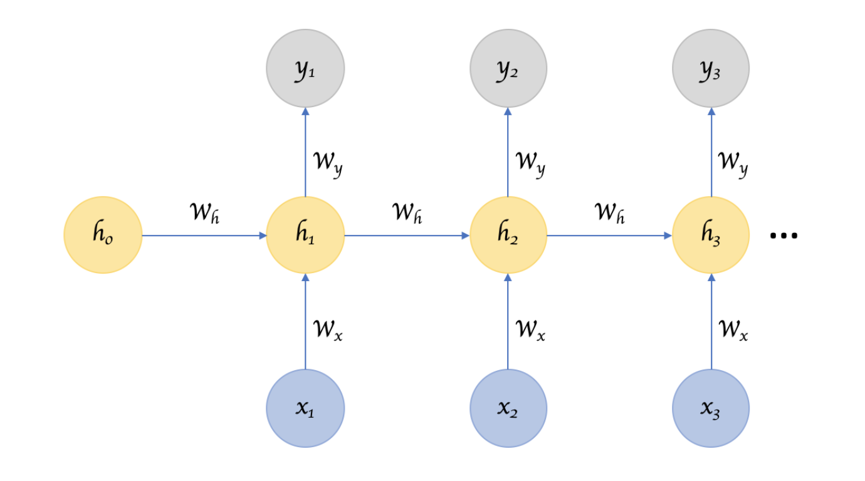
Recurrent Neural Networks
Takes arbitrarily sized inputs and
“remember” a hidden state of
information

Slide 11
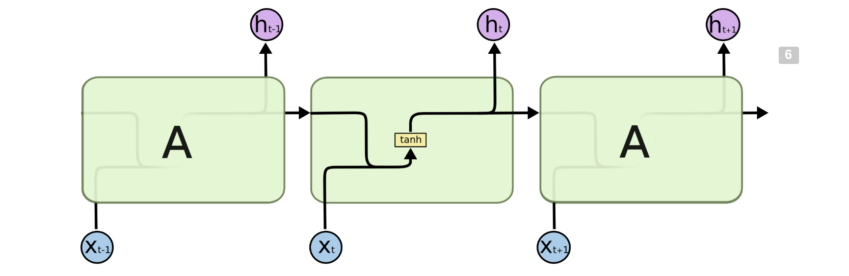
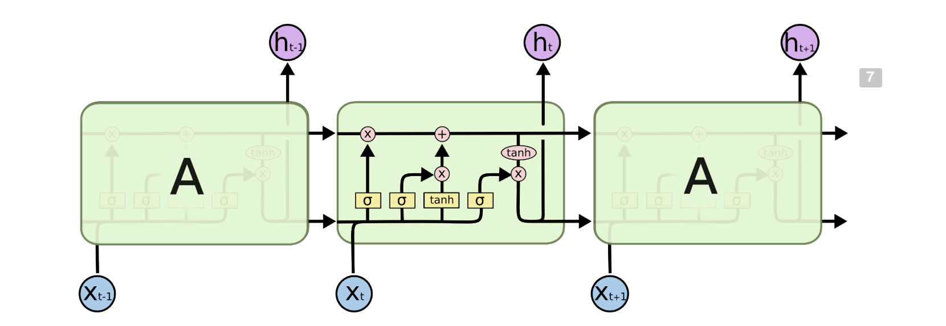
LSTMs

Slide 12
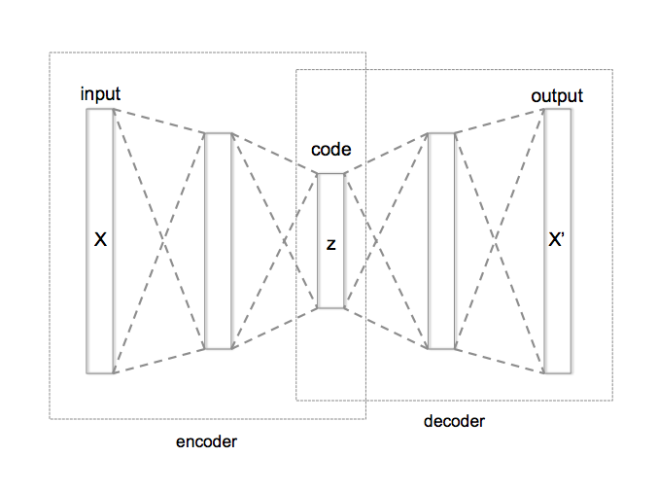
Autoencoders
Attempts to compress the data and then reconstruct the input
“Bottleneck” layer
Reconstruction
By Chervinskii - Own work, CC BY-SA 4.0, https://commons.wikimedia.org/w/index.php?curid=45555552
Notes:
Somewhat similar idea to PCA

Slide 13
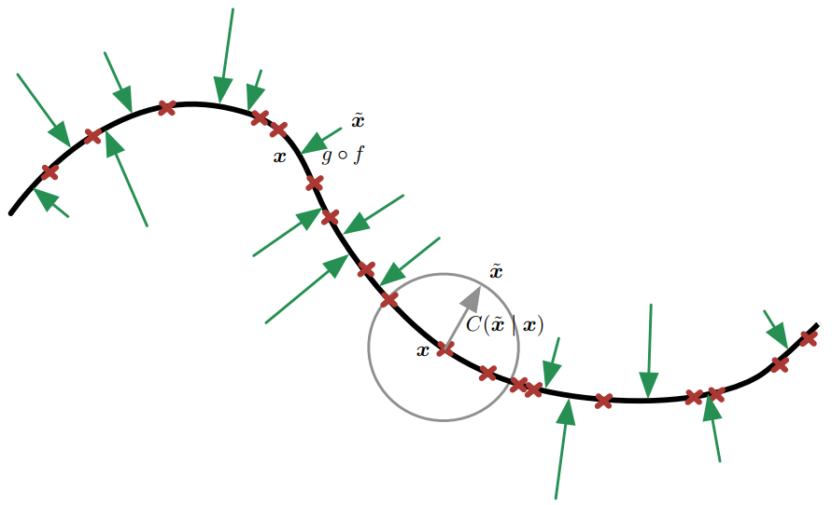
Autoencoder Applications
Pretraining
Dimensionality reduction
Information retrieval
Denoising
Data compression
Generative modeling
Batch correction
Goodfellow et al., 2016

Slide 14
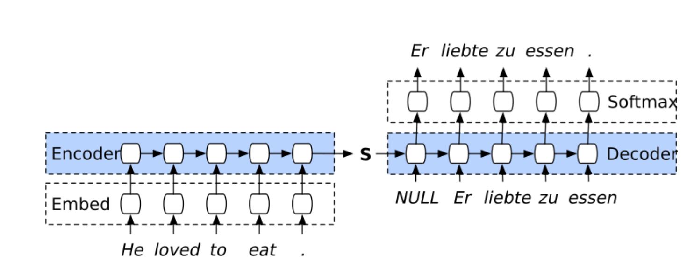
Sequence-to-sequence model

Slide 15
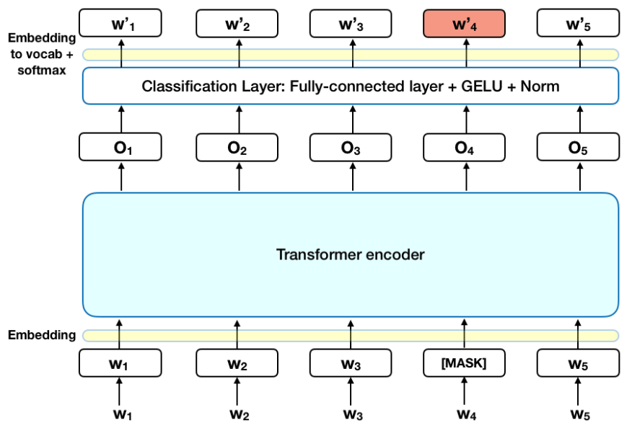
Transformer

Slide 16

Attention

Slide 17
Generative Models
Create a map from random noise into distribution of training data to generate samples
Generative Adversarial Net (GAN)
Generative model is pitted against an discriminative model that determines whether a sample is from the model or the data
Improves both generation and discrimination
Notes:
Visualization of samples from the model. The rightmost column shows the nearest training example of the column just to the left.

Slide 18
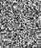

Generative Models
NNet
Noise
Something “like” training sample
Notes:
Visualization of samples from the model. The rightmost column shows the nearest training example of the column just to the left.

Slide 19
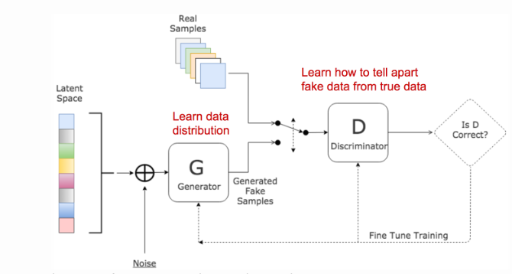
Generative Adversarial Network
Goodfellow et al. 2014

Slide 20
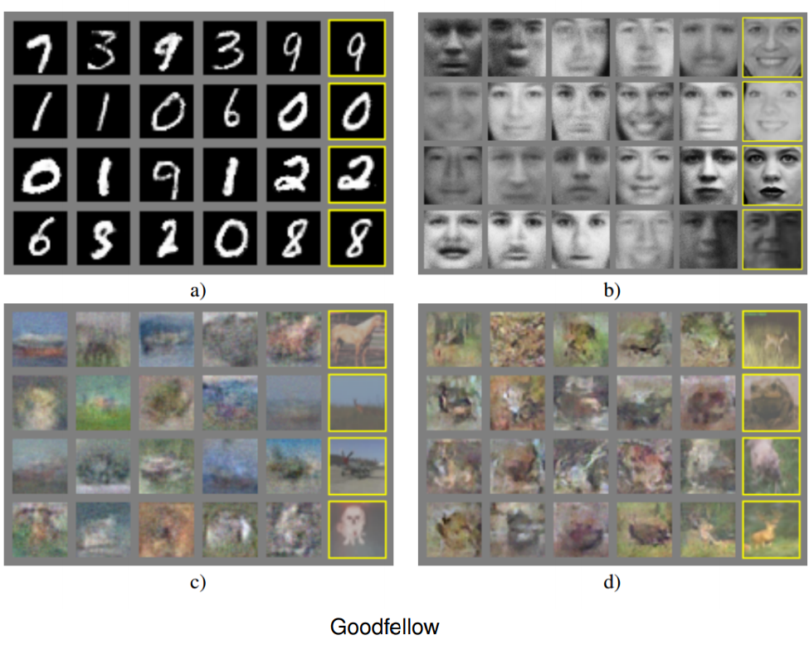
Generative Models
Notes:
Visualization of samples from the model. The rightmost column shows the nearest training example of the column just to the left.

Slide 21
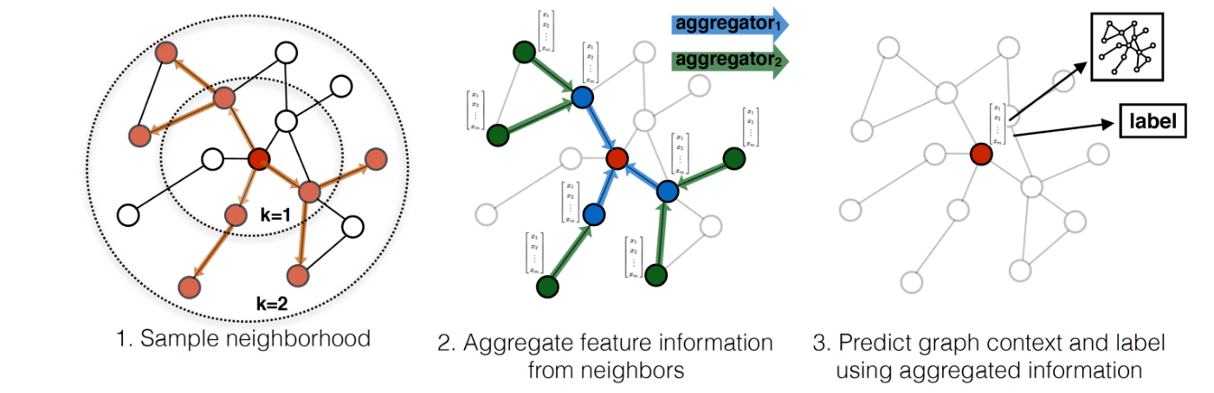
Graph Neural Network

Slide 22
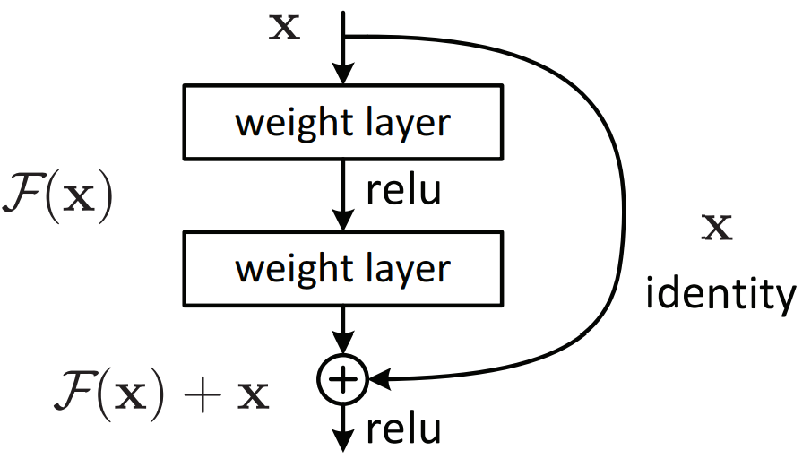
Ultra Deep Learning (e.g. ResNet)
Very deep neural nets are difficult to train
Accuracy can degrade with deeper networks
ResNet developed a framework to address this degradation
Successfully trained a 152 layer network
Won the ILSVRC 2015 image classification task
arxiv.org/abs/1512.03385

Slide 23
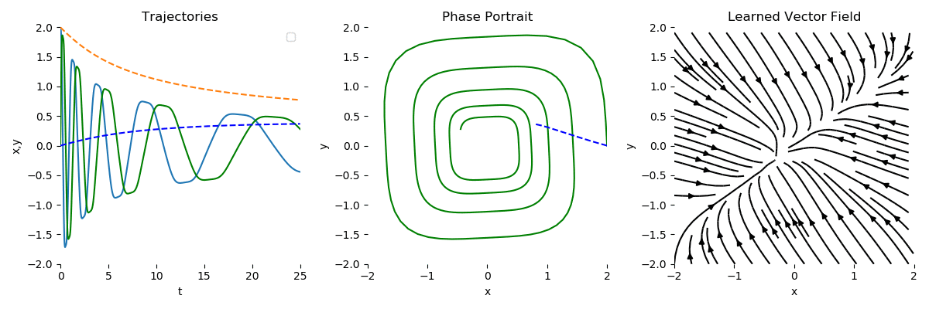
Neural ODE

Slide 24
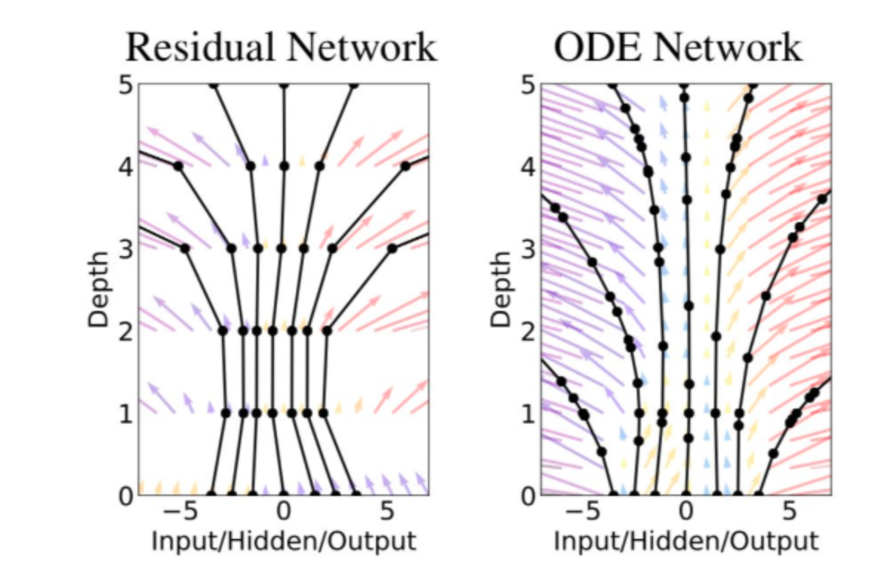
Infinite Depth

Slide 26
Final Project
To be done in groups of 3-4
Progress report in the middle of the semester
Report and Code turned the last week of classes
Graduate students turn in a longer report explaining each member’s specialization in the group (must have a specialization)
Undergraduate students can turn in the project without this

Slide 27
Applications
To create a deep learning framework for processing a particular type of dataset (genomic data, health data, physics simulation data).
Ex: Graph Neural Network for looking at spatial transcriptomic data
Recurrent neural networks for classifying or generating music
Proteomic or chemical data analysis
Deepsea: https://www.nature.com/articles/nmeth.3547
Deepbind: https://www.nature.com/articles/nbt.3300

Slide 28
Architecture and Regularization
To propose a new architectural feature or regularization to improve network performance
archetypal regularization
Consciousness prior
Attention layers
New activation function
Deepmanreg: https://www.nature.com/articles/s43588-021-00185-x
https://arxiv.org/abs/2006.12253

Slide 29
Generalization
To examine minimal conditions for generalization (level of overparameterization),
Would a network without dimensionality reduction generalize?
Would a 2-level network generalize better or worse than an n-level network
Can a certain architecture generalize from just one example?
Circumstances in which networks generalize poorly
Anomalies
Adversarial noise
Polynomially many neurons in the input size (with SGD)
Inductive bias and how it changes with
Initialization
Activations
Depth

Slide 30
Examples
Why do deep networks generalize so well?
Coherent gradients: https://arxiv.org/pdf/2002.10657.pdf
Can we find the global minima in some cases?
Neural tangent kernel (infinitely wide networks) https://arxiv.org/abs/1806.07572

Slide 31
Loss Landscapes
Effect the loss landscape has on training
Regularizations that make the loss landscape smoother
Assessing the quality of the reached minima by looking at the surrounding loss landscape
Effect of dropout: http://proceedings.mlr.press/v80/mianjy18b.html
Visualizing the loss landscape: https://arxiv.org/abs/1712.09913

Slide 32
Training Procedures
Examination of a new training procedure
Second derivatives
Momentum
Equilibrium training
https://iopscience.iop.org/article/10.1088/1757-899X/495/1/012003/pdf

Slide 33
Paradigms
Exploration paradigms for neural networks
Quantum neural networks
Neural ODEs and infinite depth networks
Binarized or logical networks
Neural ODE:https://arxiv.org/abs/1806.07366
Logical Neural Networks: https://arxiv.org/pdf/2006.13155.pdf

Slide 34
Simulations/Algorithms
Implementing an algorithm using a neural networks
Neural networks that compute diffusion maps, tSNE
Neural networks that compute earth mover’s distance
MCMC simulators
Deep reinforcement learning
Alphafold: https://www.nature.com/articles/s41586-021-03819-2
Fluid dynamics: https://www.pnas.org/content/118/21/e2101784118

Slide 35
Project Proposal
1. What is the problem that you will be investigating? Why is it interesting?
2. What are the challenges of this project?
3. What dataset are you using?
4. What Deep learning approach will you use/develop?
5. How will you evaluate your results?
Qualitatively, what kind of results do you expect (e.g. plots or figures)?
Quantitatively, what kind of analysis will you use to evaluate and/or compare your results (e.g. what performance metrics or statistical tests)?

Slide 36
Project Report (4-5 pages)
Introduction/Motivation - What is the problem you are solving? What need does it solve?
Background/Related Work - What has been done before? What frameworks have been proposed? What are the limitations of the previous work?
Model: What is your neural network model/architectural feature etc? What interesting properties does it have? <Model Schematic>
Empirical/Theoretical Results: Validation on relevant datasets, evidence of model generalization, proofs of algorithms etc. <Results Tables>
This could be a where grads talk about what each member focused on
Conclusions/Future work: Where can this work go in the future?

Slide 37
Example from 2019: Style Transfer
This project was centered around the problem of Style Transfer
Images of a Tabby or Egyptian cat and performing a transformation on the images to yield images of the opposite cat breed.
The methods used to achieve this style transfer were several Generative Adversarial Network architectures, specifically DiscoGAN, CycleGAN, and UNIT.
While none of these networks was ultimately able to provide excellent performance for the problem at hand, they each ran into distinct issues due to their different architectures and designs.

Slide 38
Example from 2019: Music Generation
Music generation poses an interesting problem in the world of modern deep learning. Deep learning has progressed to a point where the domain of art, previously believed a solely creativity- driven human pursuit, has been infringed upon by computers. Methods like style transfer and DeepDream have shown deep networks ability to generate novel images. [1][2] Further, Google's Project Magenta group has shown a networks ability to create meaningful music from midi data. [3] However, the midi format can often ignore the structure of a musical piece, and thus a network has more diculty replicating the signal behind it. By the use of two Seq2Seq networks and a SeqGAN, we have created a network capable of algorithmic music generation that is designed around the structure of music.

